Slide 1
COVID notes for RFH medics

Slide 2
About COVID19
Caused by SARS-CoV-2, person to person spread:
Stable for hrs-days: plastic and steel (72hr) > cardboard (24hr) > copper (4hr)
Can be in aerosol for >3hr [https://www.nejm.org/doi/10.1056/NEJMc2004973]
Incubation: up to 2 weeks
R₀: 1.4-3.9 (new infections for each infection)
DIAGNOSIS: Testing for nuclear acid (RT-PCR/NGS)
Viral shedding 3-5 days after symptoms -> early false –ve test initially
Can test specific IgM/G (↑ 4x in recovery phase) in high suspicion –ve pts

Slide 3
RFH protocol for ?COVID
PROTECT YOURSELF (Risk assess+PPE+buddy) +
IDENTIFY
NB NO stethoscopes
Airway procedures and manipulation ONLY with seniors present
ISOLATE
INFORM
ID SpR #1437 or via switchboard:
Micro/Virol SpR 9pm-9am or ID Cons 24/7

Slide 4
Presentation
Respiratory symptoms/Fever + travel Hx + contact Hx
Include within last 2-3 weeks (incubation time)
Co-morbidities (worse/faster progression)
CHD, HTN, DM
Disease clustering (symptomatic cases at home, school, offices)
Dynamic change in global spread, travel Hx may be not as informative as before as many places now at risk.
 | Mild | Moderate (80% Mild-Mod) | Severe (15%) | Critical (5%)
Clinical: | Mild Sx | Fever, respiratory symptoms (cough, SOB) | RR≥30 O2≤93% (ARDS): PaO2/FiO2 ratio<300 mmHg (40 kPa) | Respiratory failure Shock ITU
Imaging (CXR, CT) | Imaging –ve | Imaging +ve (pneumonia manifestations (Bilateral/Ground glass), pulmonary oedema) | >50% lesion progression within 24-48hr

Slide 5
Requesting at RFH
Discuss with ID
3 canisters (@ specimen reception)
Category A (confirmed), B (suspected)
1 & 2 = send-away protocol
Other samples: stool, urine, sputum should NOT be sent until exclusion
Note about samples:
DO NOT shute
Separately, double bagged COVID samples
Only troponin can be added on to COVID test for ED or ITU patients.
Hand deliver

Slide 6
Inflammatory indicators
Bloods (inflammatory response picture)
FBCs (esp. lymphopenia) | ↓ WCC especially: ↓ lymphocytes (downward trend -> severe) – prognostic indicator
CRP | ↑ (Rapid rise/↑↑ -> secondary infection)
D-dimer | ↑↑ in severe cases
LDH | ↑
Procalcitonin | N/↓
Ferritin | ↑
Cytokines (IL-6, IL-10, IL-4 TNF-𝛼, IFN-𝛾) | ↑
LFTs | ↑ AST, ↑ ALT
Also reports of raised troponin, CK and myoglobin

Slide 7
Initial management – largely supportive
Oxygen: aim for standard SpO2 targets (>92-96%, 88-92% CO2 retainers)
High flow nasal cannula: wear a surgical mask
Fluids: careful fluid balance
Excessive fluid worsens hypoxemia
Avoid nebulized route of administration: IV or inhaler+spacer
Monitors: RR, O2, PaO2/FiO2
Consider (suspect secondary bacterial/fungal infection) empirical antibiotics/antifungals - d/w ID
Factors for poor prognosis: Age, co-morbidities, high SOFA, D-dimer.
Deterioration: call ID consultant, A&E consultant, PART, or ICU consultant.
Do not call the resuscitation team. Do not move the patient to resus.
Likely intubate early better vs NIV; mechanical ventilation as for ARDS
For interest, other treatment proposed/trialed include:
Anti-virals: lopinavir/ritonavir/chloroquine -> liver side effects
Cytokine cascade inhibition: methylpred

Slide 8
Improving patients
Based on discharge standards elsewhere, likely involves:
Apyrexial >3d
SpO2 >93% w/o O2
NAT –ve x2 24hr apart (+/- -ve IgM and IgG 7d post symptoms) – exclude infection
Improved respiratory symptom and imaging
On discharge:
Home isolation for 2 weeks (+ advice on precautions)
Follow-up needed (ID to advise)

Slide 9
Resources and references
Global MediXchange for Combating COVID-19
A Seattle Intensivist’s One pager on COVID-19 by Nick Mark
RFH COVID19 Operational Plan
Zhou F et al. Clinical course and risk factors for mortality of adult inpatients with COVID-19 in Wuhan, China: a retrospective cohort study. Lancet. 2020 Mar 11.

Slide 10
Additional slides

Slide 11
Imaging
Serial imaging to assess progression (usually over 7-10 days)

Slide 12
Additional imaging
Slides from PPT from Claire Mason

Slide 13
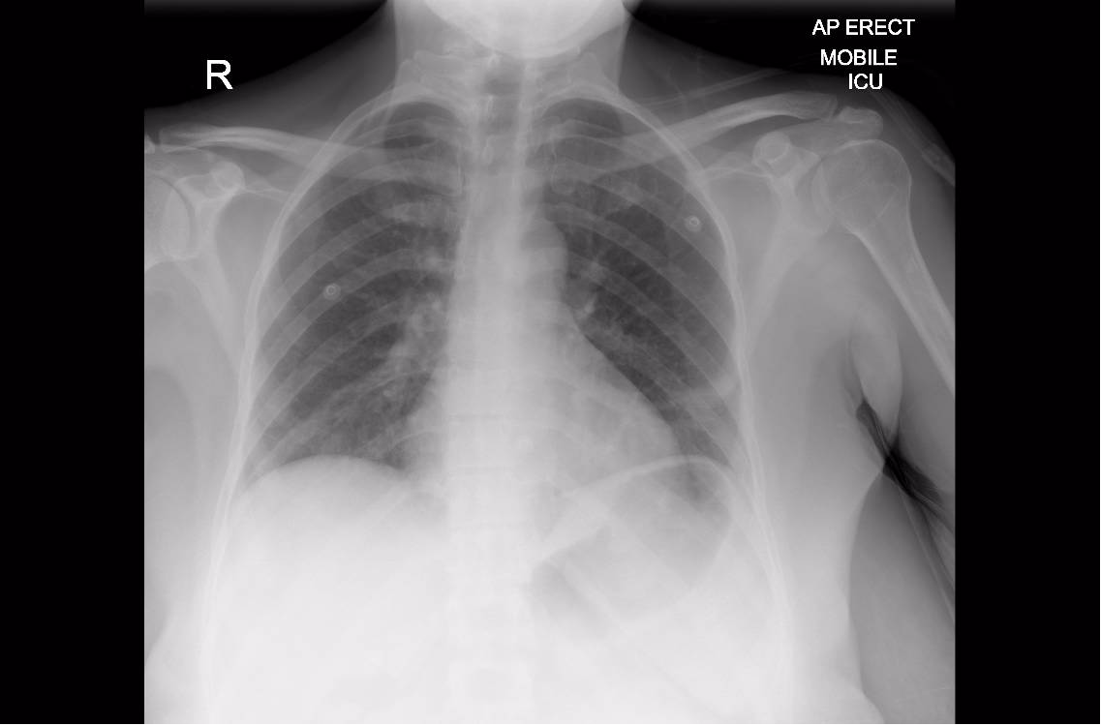
Notes:
COVID-19

Slide 14
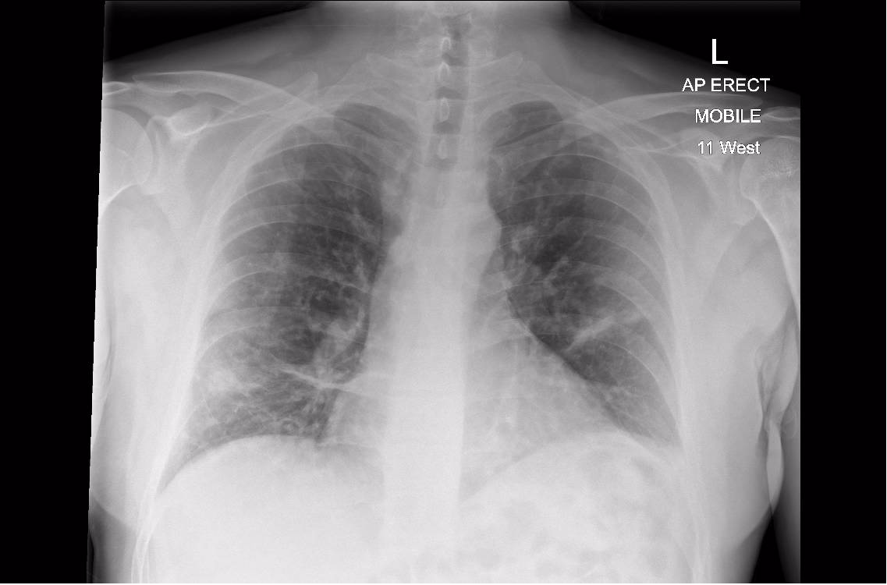
Notes:
COVID-19 – patient A – D1

Slide 15
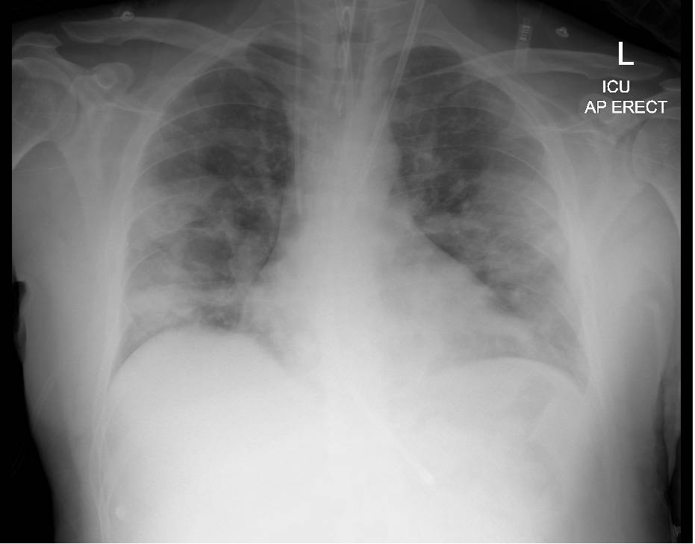
Notes:
COVID-19 – patient A – D4

Slide 16
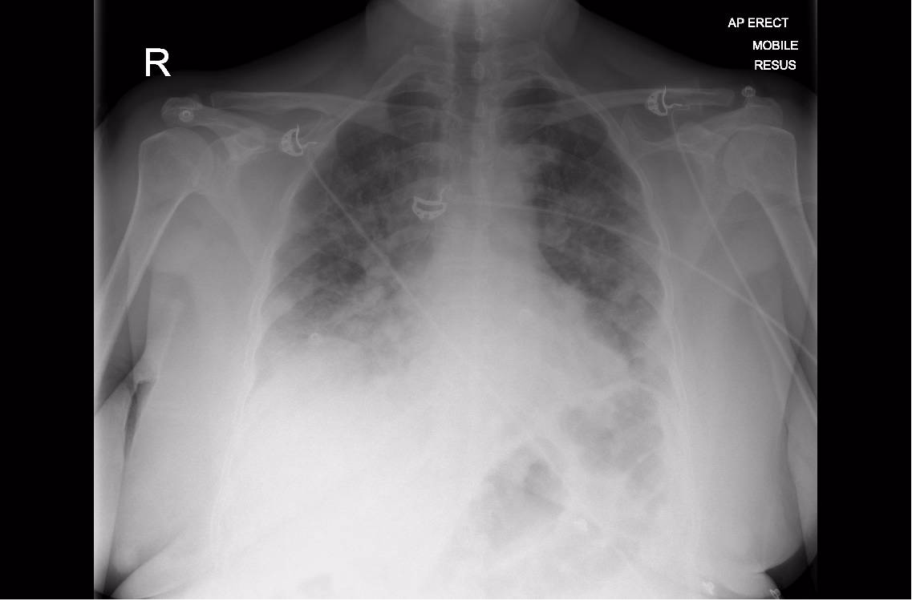
Notes:
COVID-19

Slide 17
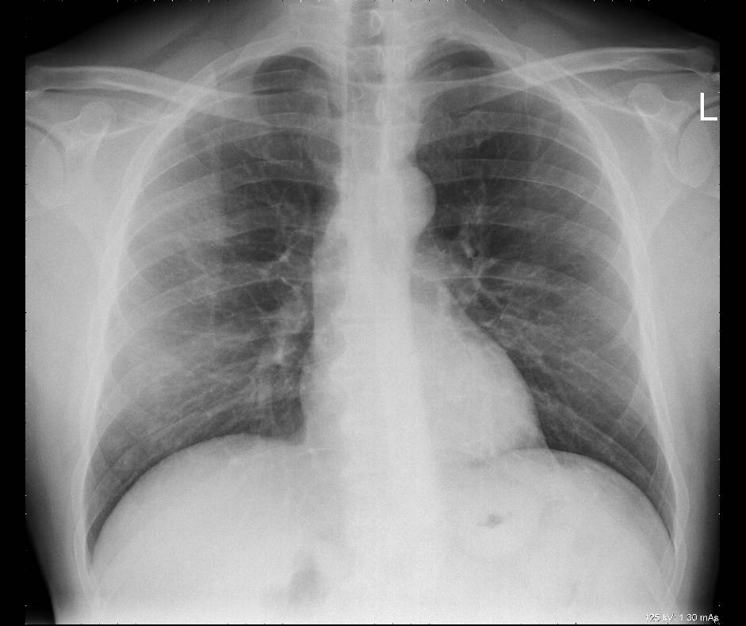
Notes:
COVID-19 – patient B – D1

Slide 18
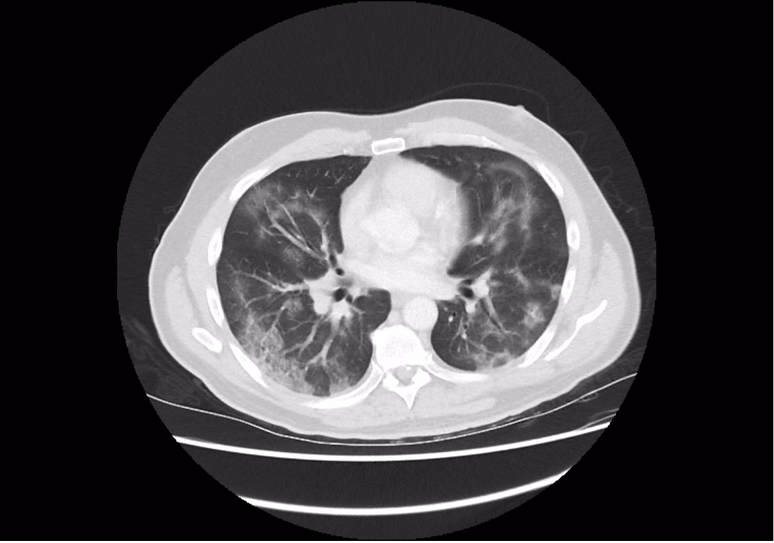
Notes:
COVID-19 – patient B – D1

Slide 19
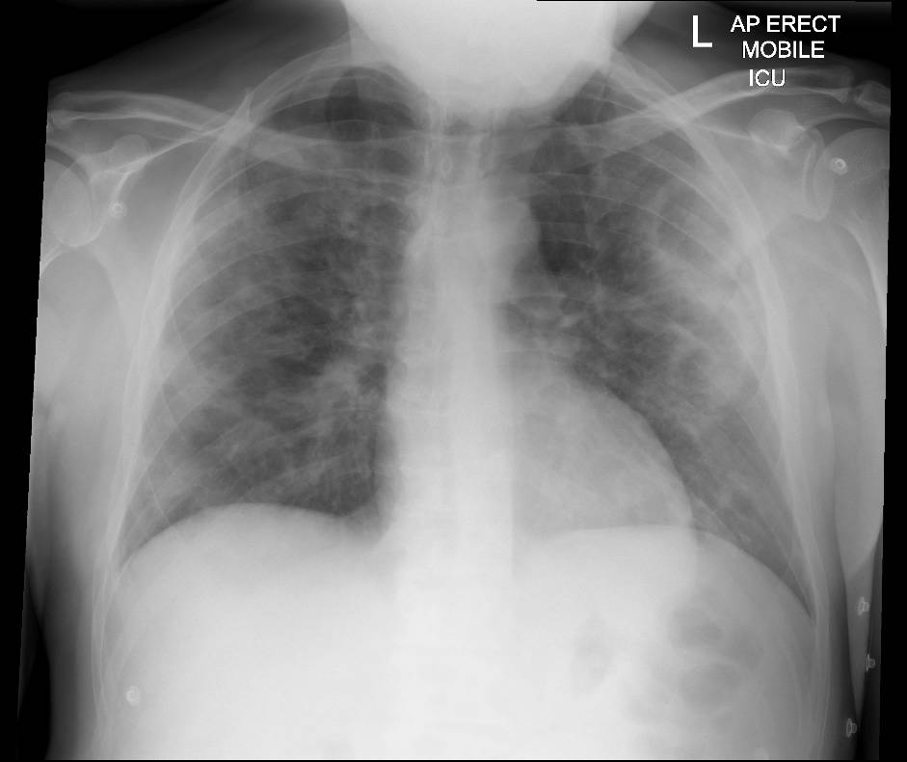
Notes:
COVID-19 – patient B – D7

Slide 20
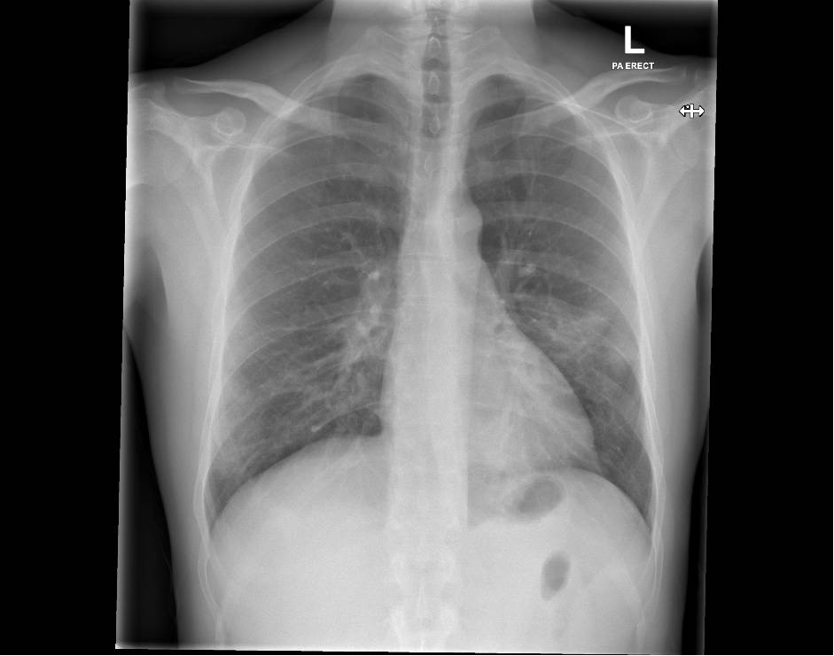
Notes:
COVID-19

Slide 21
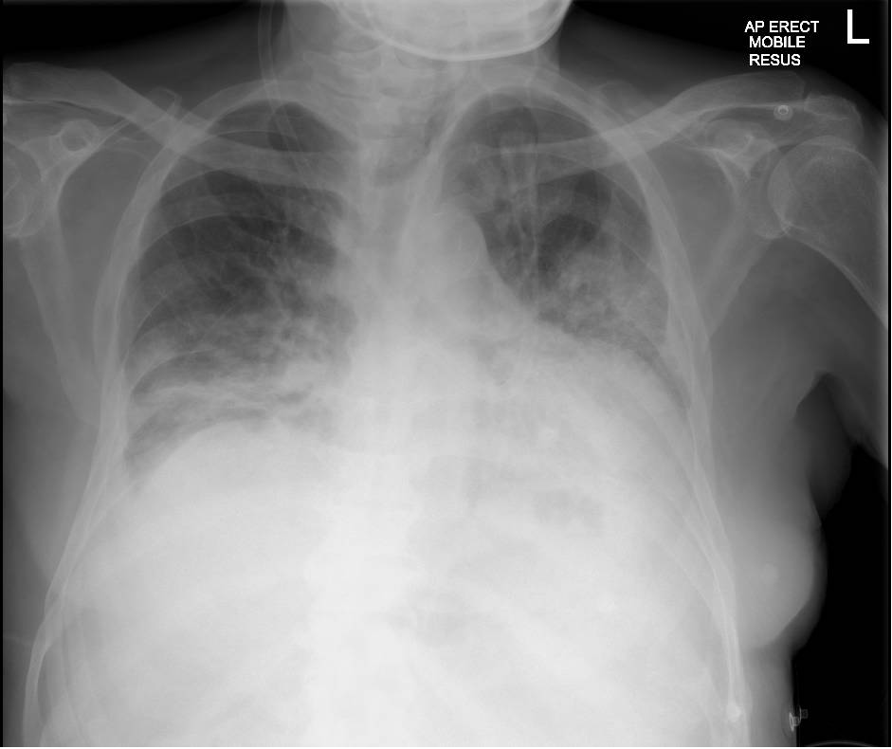
Notes:
COVID-19

Slide 22
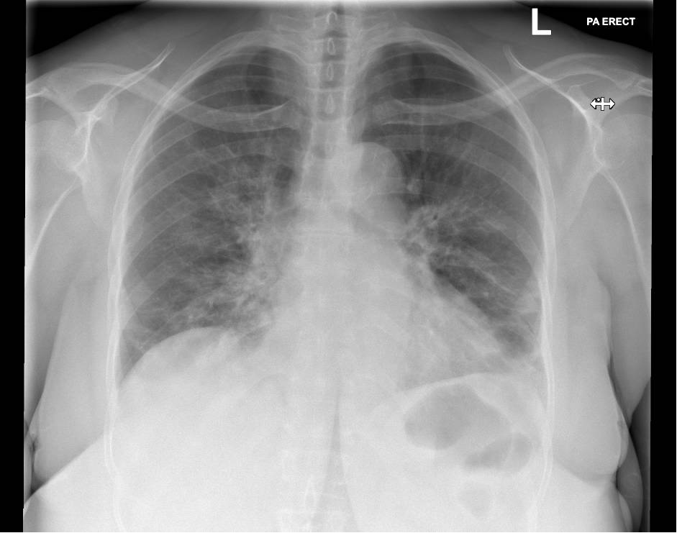
Notes:
COVID-19

Slide 23
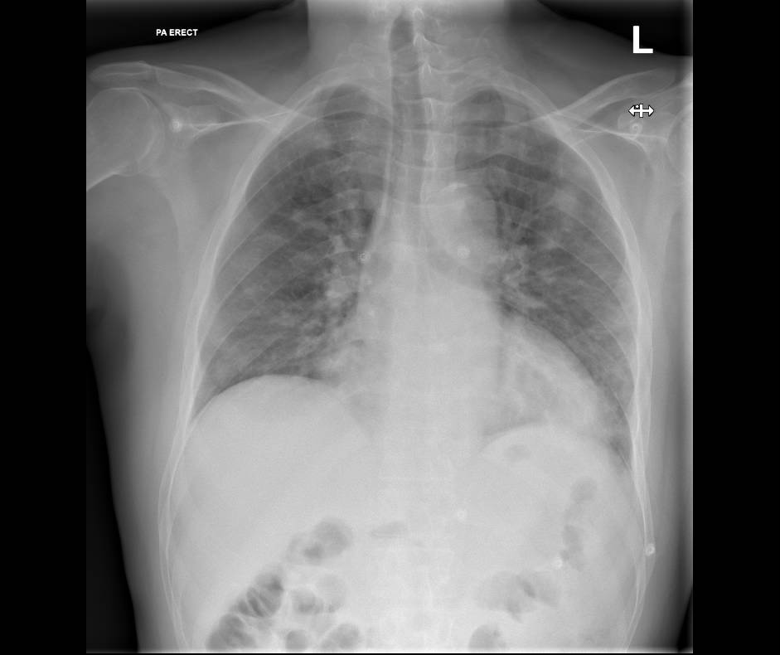
Notes:
COVID-19

Slide 24
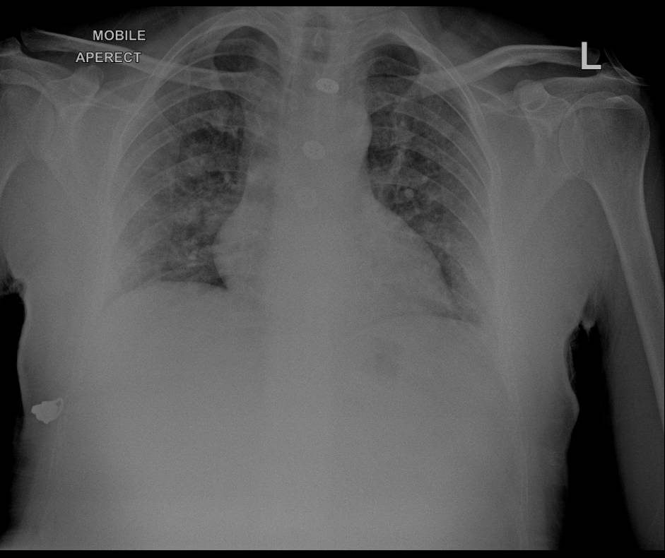
Notes:
COVID-19

Slide 25
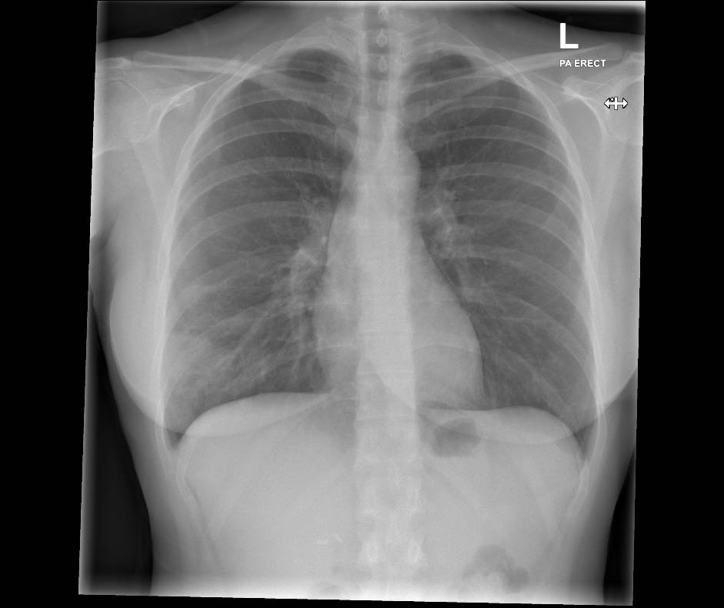
Notes:
COVID-19

Slide 26
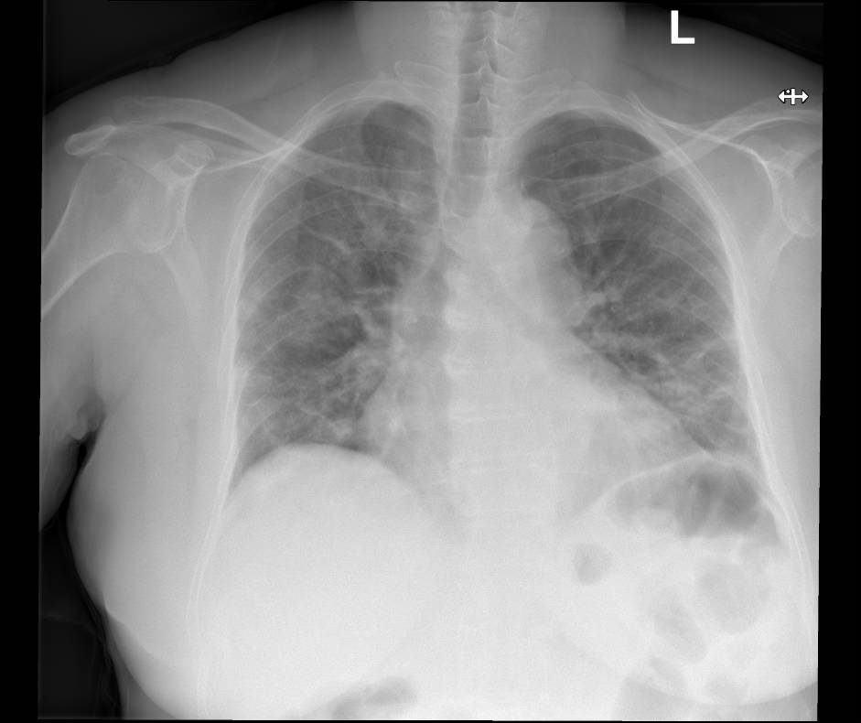

Slide 27
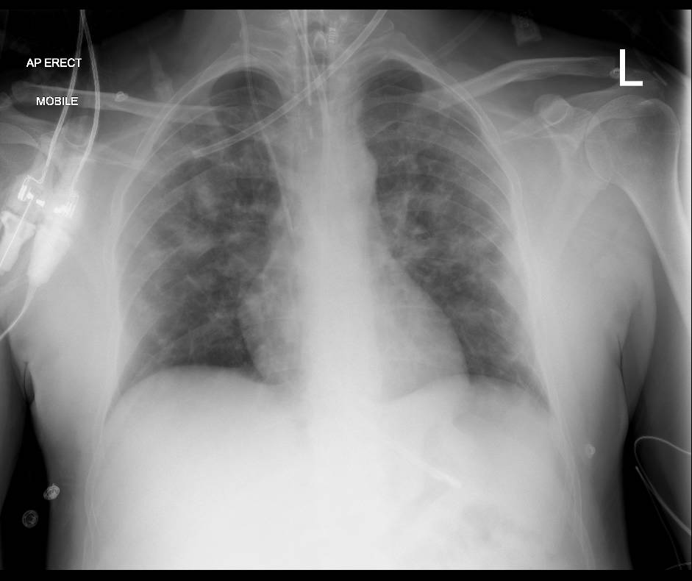

Slide 28
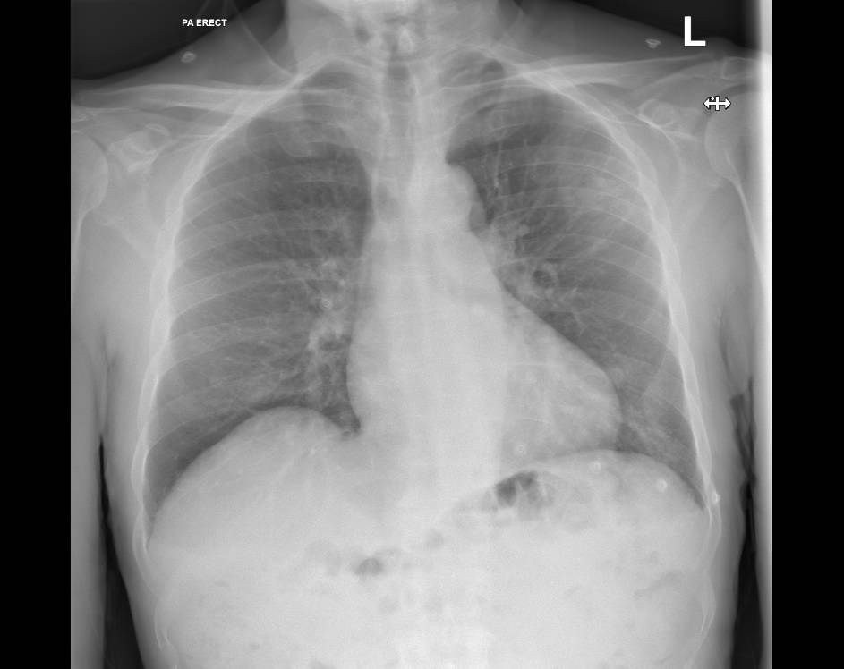

Slide 29
